Slide 1
Deep Learning & AI Community
Kshitiz Rimal, Developer Sessions

Slide 2
Kshitiz Rimal
Intel AI Student Ambassador
AI/Deep Learning Enthusiast
Full Stack Developer
UI/UX Designer

Slide 3
Topics
What is Deep Learning?
How to get started ?
Tools to follow
Community Role

Slide 4
What is Deep Learning

Slide 6
Deep Neural Networks

Slide 7
Example: Recognizing Faces
https://www.youtube.com/watch?v=AgkfIQ4IGaM

Slide 8
Applications
Voice Recognition Object Detection Prediction Generate Content

Slide 9
How to get started?

Slide 10
Know your interest
Implementation : Programmers/Developers
Academic Interest: Academic Researchers
Not sure: Anyone who is new to this field

Slide 11
Implementation based learning
Best Language to pick is Python
If you don’t know python, learn python first
Take Hands on Course
Search courses based on keywords such as hands on, implementing etc
Pick one framework
Framework based learning
It’s a crucial step for implementation based learning, once you learn one framework, it won’t be hard to learn others
Follow tutorials based on that framework
Read official tutorials on that framework
Read docs
Read blog posts

Slide 12
Hands on Courses
Free
Youtube: Sentdex’s Machine Learning Course
Fast.ai : Part 1 & Part 2
Paid
Udemy: Deep Learning A-Z
Udemy: Practical Deep Learning with PyTorch

Slide 13
Academic Interest
Check your skills
Most theory based courses requires you to understand proper math skills
Specially in deep learning you will need to have intuitive level understanding on Linear Algebra, Derivative/Partial Derivative, matrix and vector operations
Search for courses by popular Universities
Coursera can be one of the top place to search for these type of courses
Followed by that stanford has great courses
Another great place is edx
Watch Conference Videos
Check out videos from conferences such as O’reilly AI conference, NIPS etc.
Follow Blog Posts
Search and read blog posts from websites like medium, Technology review etc
Read Arxiv Papers

Slide 14
Theoretical Courses
Coursera: Machine Learning — Andrew NG
Covers Basics of Machine Learning and some portion of deep learning
Mostly theoretical
Coursera: Deep Learning.ai — Andrew NG
Covers Deep Learning from theory side
Implementation based on python
Stanford: CS231n — Convolutional Neural Networks for Visual Recognition
Covers convolutional neural networks in depth
With some code snippets examples
Stanford: CS224n — Natural Language Processing with Deep Learning

Slide 15
Not sure??

Slide 16
Hybrid Approach
Learn about basic theory from blog posts and articles
Take One Implementation based courses
Then, If you like to code more, follow implementation approach
Else, Take theoretical Approach

Slide 17
Hybrid Approach
Theory Articles
Neural Networks and Deep Learning Online book first chapter
http://neuralnetworksanddeeplearning.com/index.html
Chris Olah Blog Post
http://colah.github.io/
Course
Fast.ai Part 1 Course

Slide 18
Tools to Follow

Slide 19
Top Frameworks
Tensorflow
PyTorch
Keras

Slide 20
When to choose what?

Slide 21
For new learners In python and Deep Learning
Choose Keras
Its easy to learn
Its intuitive and modular in nature
No extra effort to learn the framework
Easy model implementations
Based on Tensorflow

Slide 22
Some Programming experience and knows some theory
Choose Tensorflow
It is production ready
You can build apps with it
It has good documentation to follow
Good ecosystem to support
Many Learning Resources

Slide 23
Experienced Python Programmer or Deep Learning Researcher
Choose Pytorch
Perfect for experienced python programmer
Intuitive APIs for researchers
Fast and easy to test out new ideas
Still in beta phase
Not production ready
Popular among researchers

Slide 24
Community Role

Slide 25
Need
Started as Personal Necessity
An ecosystem to support educational environment
A place to share and improve ideas regarding AI and Deep Learning
Resource facilitator

Slide 26
Developer Sessions
AI first Community dedicated towards providing
AI Education
AI learning environment
Resources (Learning materials, testing and training environment)
Expert suggestion and mentoring
Facebook.com/groups/developersessions

Slide 27
What we did so far

Slide 28
July 7 ,2017 — First Deep Learning based Counselling session August 3/4 ,2017 — 2-day Workshop on Prerequisites on Deep Learning — Workshop on Convolutional Neural Network, Recurrent Neural Network, Transfer Learning and Fine tuning October 14 ,2017 — Meetup on Artificial Intelligence and Its Ecosystem — talks about Machine Learning, Open Data, Big Data and Deep Learning

Slide 29
Intel Support
Learning Material, Deep Learning video courses
DevMesh Platform
Online platform to publish your projects, seek mentors and collaborate with others
Training and Testing Resources
Intel Xeon & Intel Xeon Phi Cluster Access
Framework and Software access
Neon Framework, Tensorflow*, Keras*, Caffe*

Slide 30
NVIDIA deep Learning Institute
Deep Learning Kit
Course designed by Yann LeCun, FAIR Director, NYU Professor
AWS & Qkwik Labs Free Access for deep learning Training

Slide 31
What we are trying to do

Slide 32
Implementation based Workshops
Goal
To make you familiar with just enough theory to get started
Framework based implementation
Making you easier to follow along any deep learning course online
To quickly develop and built prototypes on deep learning
Inspire to create app/business with AI first mindset

Slide 33
Implementation Based Workshop
Nature
2/3 days duration
Framework based Implementation and training
Project oriented approach
At the end, participants will create their own project
All the codes, ideas on that project will be open source
So that new participants can learn from them and develop ideas on top of that

Slide 34
AI Community in Nepal
With all these workshops and projects we are creating a community of AI enthusiasts in Nepal
A place where interested people come together and share and develop ideas
A place to learn
A place to test and develop Ideas
A Place to seek mentorship and suggestions

Slide 35
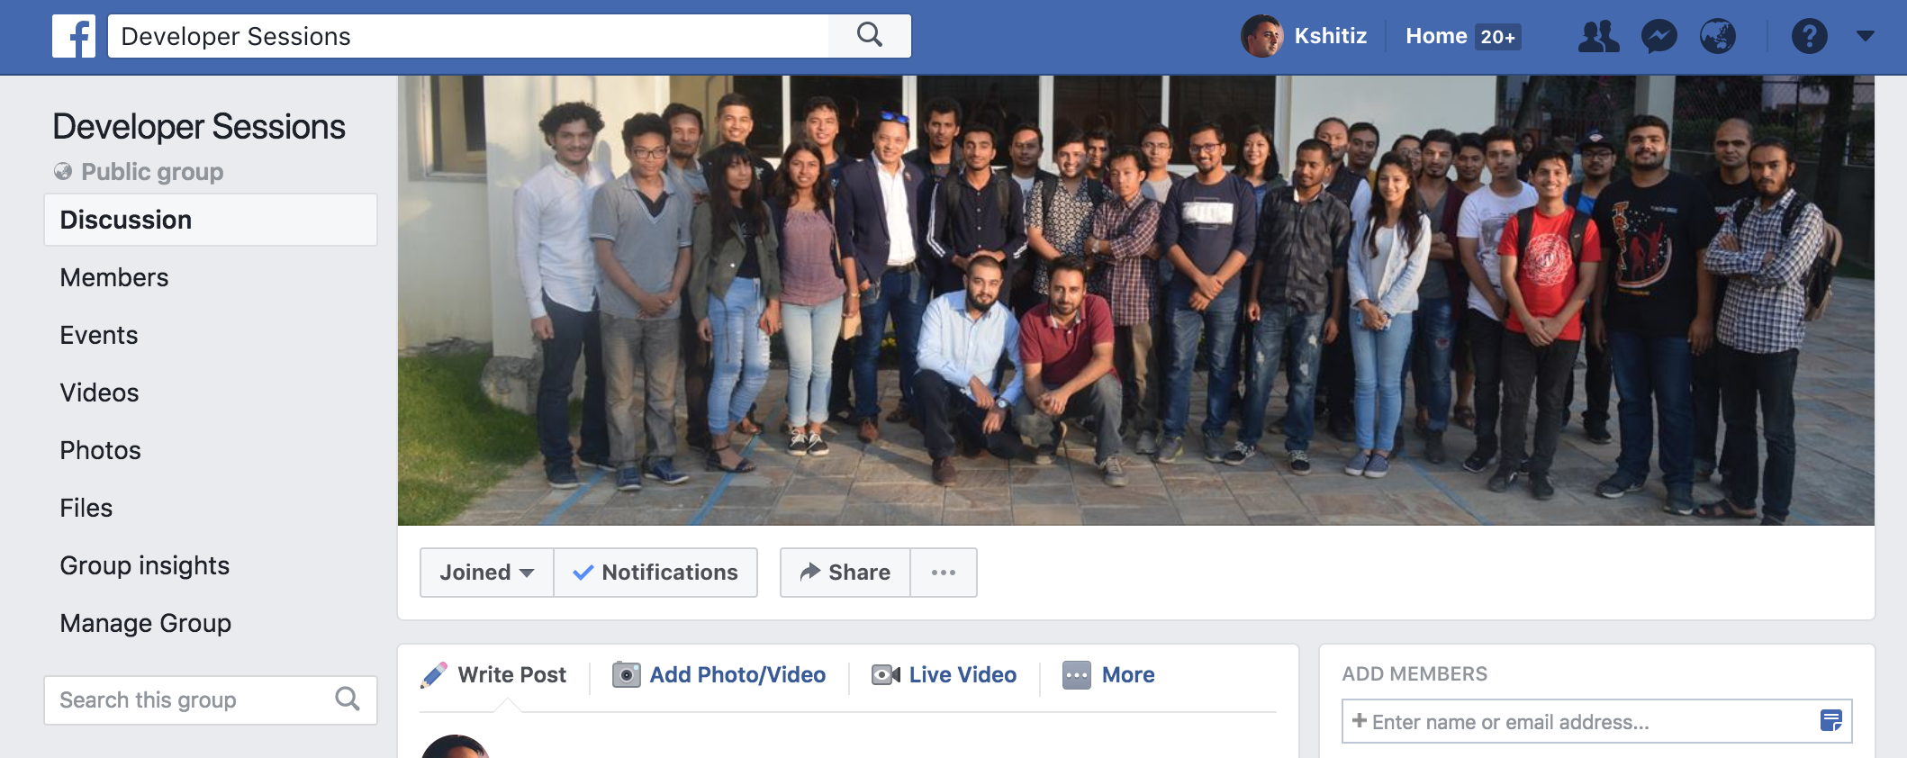
Our Group: Developer Sessions facebook.com/groups/developersessions

Slide 36
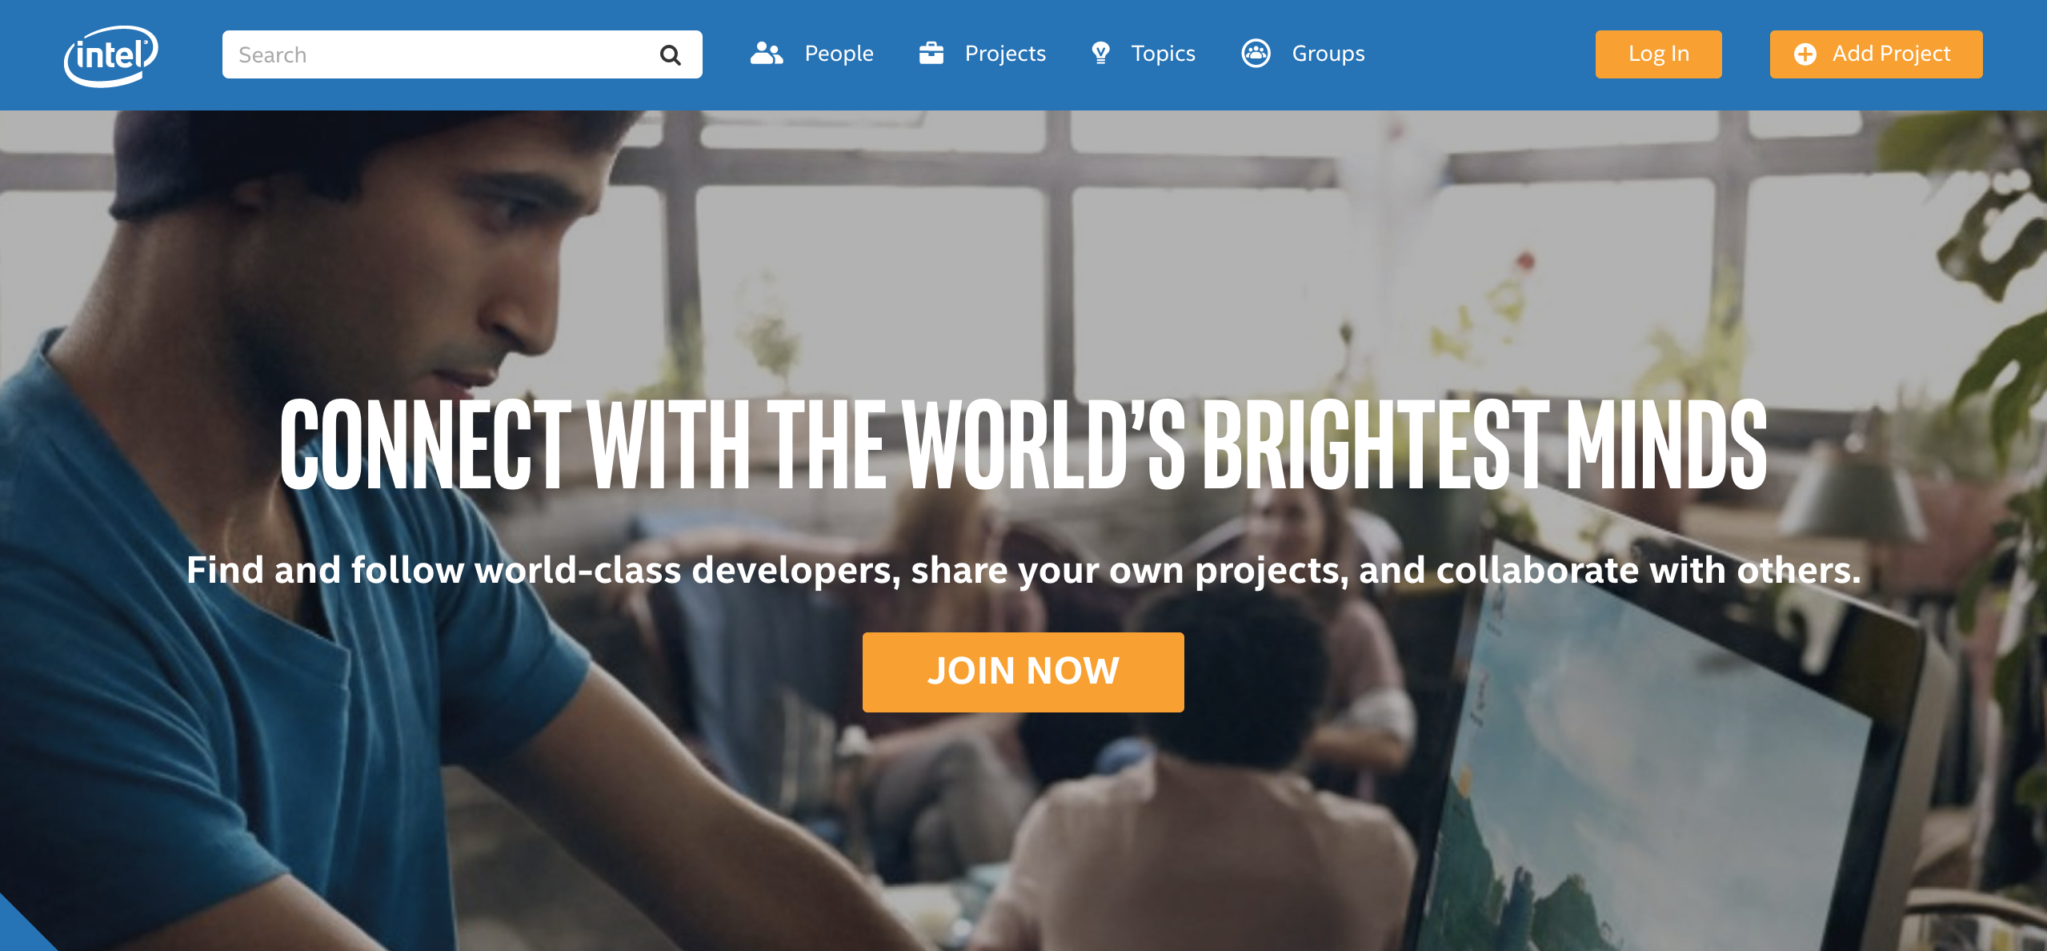
Intel DevMesh Platform devmesh.intel.com

Slide 37
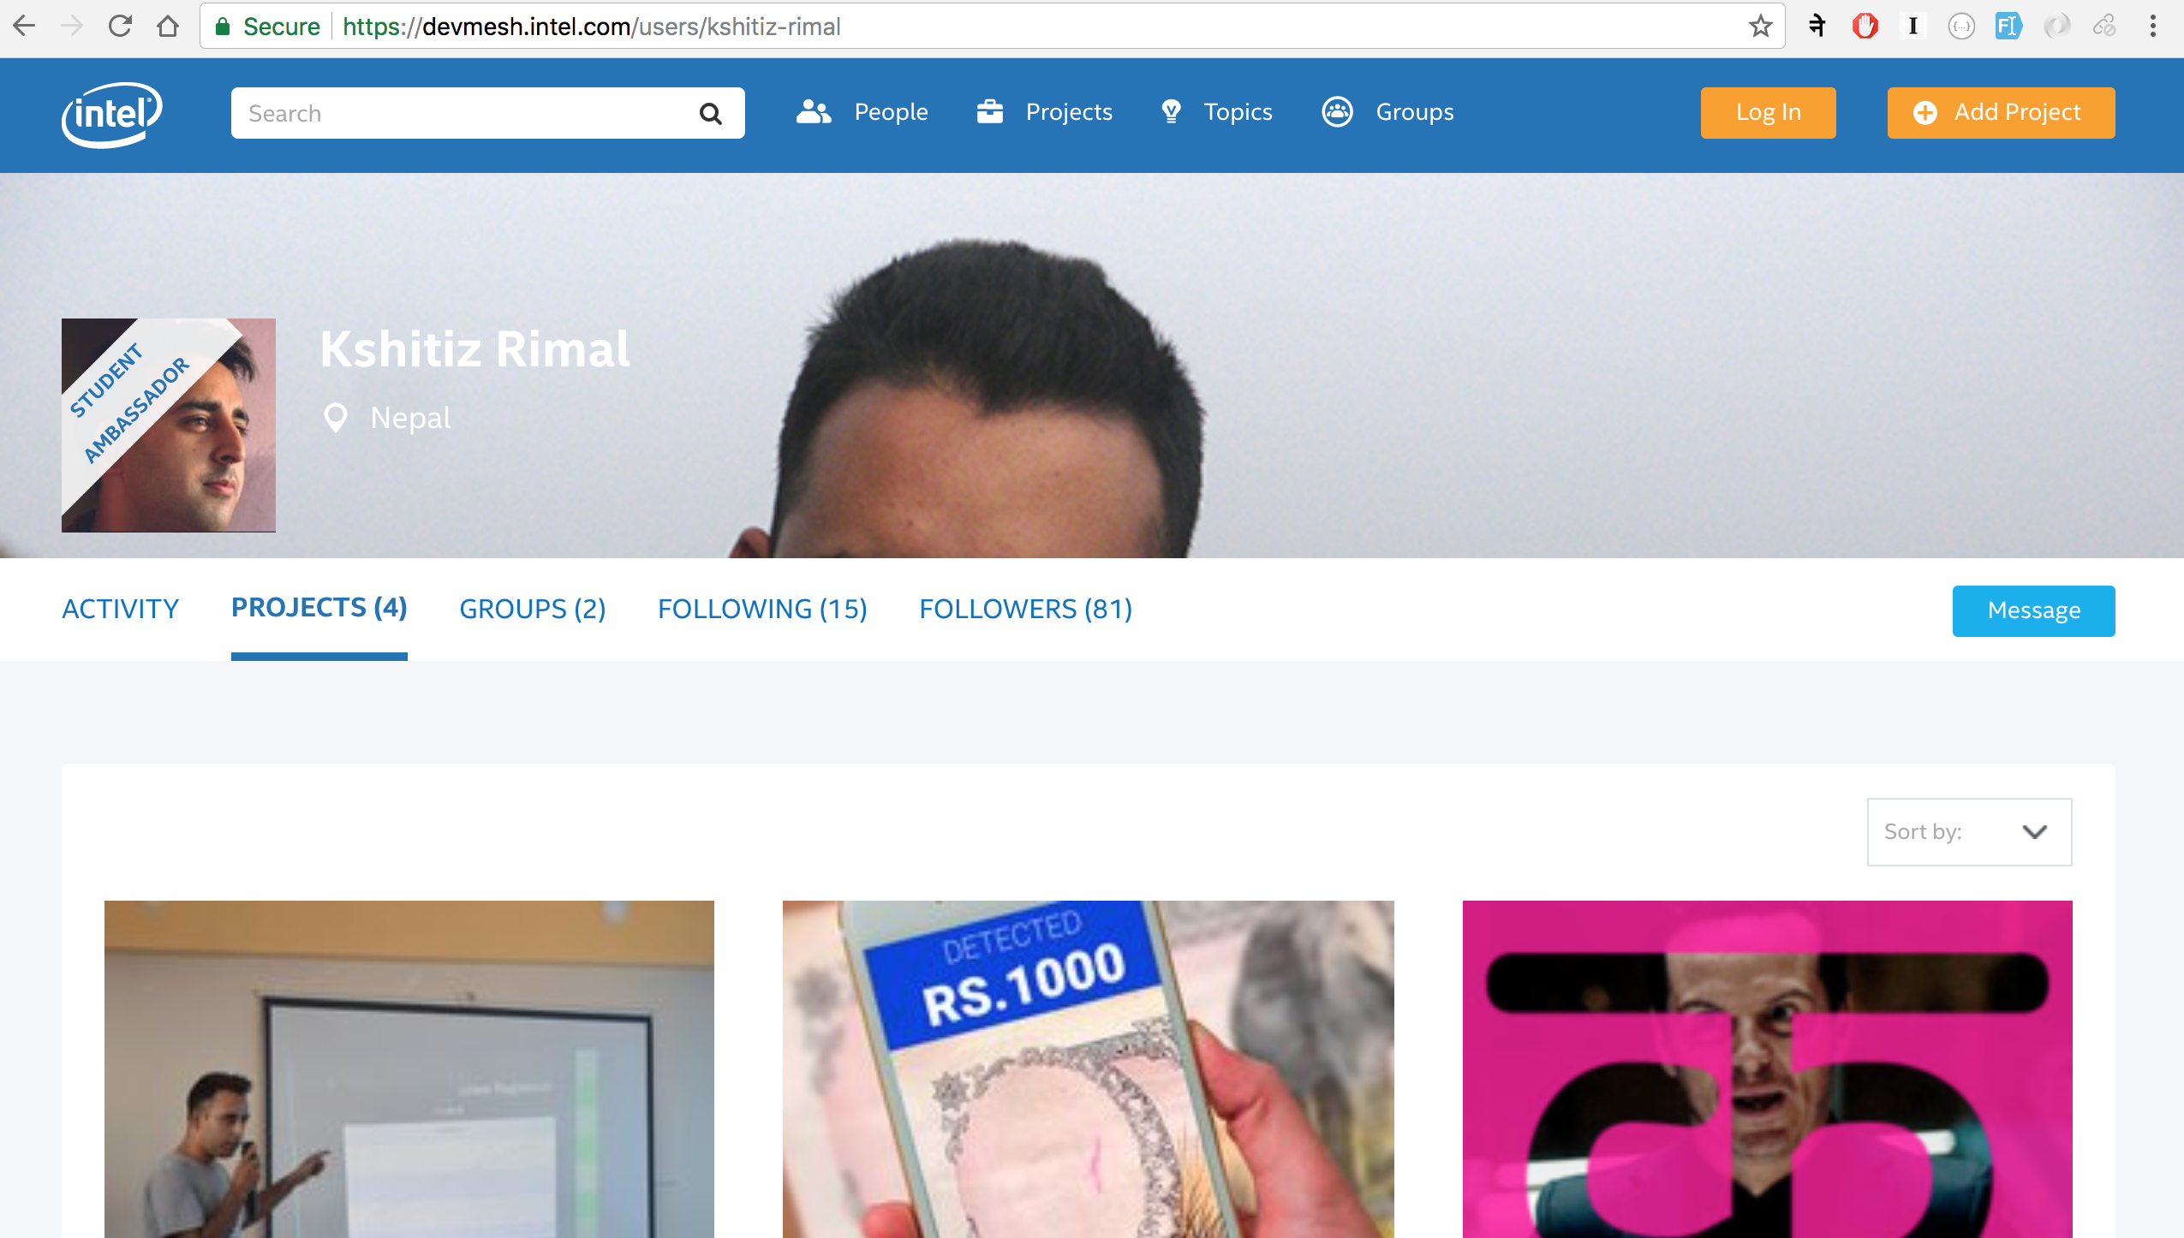
DevMesh Profile devmesh.intel.com/users/kshitiz-rimal

Slide 38
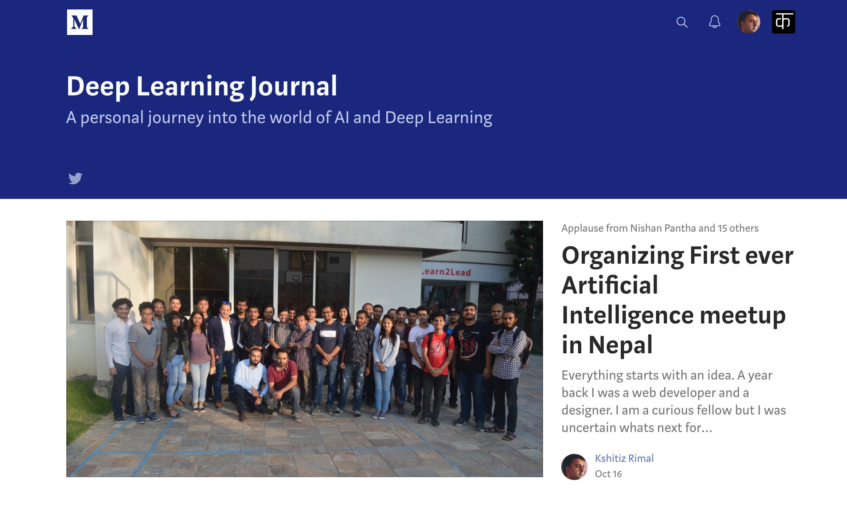
Deep learning Journal on Medium medium.com/deep-learning-journals

Slide 39
Summary
Deep Learning Related Workshops
To quickly train individual on implementing these models using Python Frameworks
Goal is to provide prerequisite knowledge quickly so that they can easily take any online course and master the subject
Provide a community to learn, test and develop ideas and projects based on AI and deep Learning
A channel to facilitate collaboration between individuals

Slide 40
Q&A

Slide 41
Thank you ☺

